Slide 1

Multivariate STATISTICS & econometrics

Slide 2

Case 1
On the morning of Feb 3, 2012, deputy general manager of Mahindra & Mahindra Ltd, Farm Division (MMFD), received a telephone call from a dealer. Dealer was complaining about the irregular and short supply of tractors from the company stockyard. He finally ended the call after assuring the dealer that he would get the problem resolved.

Slide 3
Company at a glance
Mahindra & Mahindra LTD was founded in 1945, it is a multinational company group worth of US$15.4 billion. MMFD provided tractors and agricultural equipment under ‘Mahindra Tractor’ brand name. It had four tractor manufacturing facilities in India, two in China, one in Australia and three in United States. It had been the largest tractor producer in India since 1983.

Slide 4
India tractors-market share (%) source- www.Mahindra.Com
Producers | FY09 | FY10 | FY11
Mahindra | 40.8 | 41.4 | 42.0
TAFE | 22.3 | 22.0 | 20.4
Escorts | 13.5 | 13.3 | 13.2
Sonalika | 8.9 | 8.7 | 8.6
FNH | 5.3 | 4.8 | 5.1
JD | 6.0 | 7.0 | 8.0
Others | 3.1 | 2.8 | 2.7

Slide 5
MMFD’s business model
MMFD had more than 800 dealers selling its tractors across India. The tractors were manufactured in one of the four plants located at Mumbai, Jaipur, Rudrapur and Nagpur and were then transported by road to one of the company’s stockyards, which were located in each state. MMFD had 26 sales offices located across India. Their main role is to coordinate between dealers and the company.

Slide 6
These sales offices provided a rolling tractor demand forecast for the current month plus two months in the future. This forecast was used to manufacture tractors and to enable placing parts supply orders in advance. The manufacturing plants supplied tractors to the stockyards as per the current monthly forecast. The tractor availability in the stockyards was the key concern given the demand from sellers according to the sales season. Demand for tractors followed a seasonal pattern; the peak seasons were, April through June and September through November.

Slide 7
The forecast & supply chain dilemma
Dealers were carrying tractor stock equal to 40 days of their annual sales, and an additional 20 days of stock were held at company stockyards. Thus, there were 60 days of finished goods waiting for customers, who were willing to wait for 5 to 15 days to receive a new tractor. The production of tractors was driven by material availability as well as changing customer demands.

Slide 8
Mr. Menon did not want to lose sales; therefore, to cater to market demand, he frequently did mid-month revisions in the forecast plan and inter-stockyard transfer of tractors in order to meet dealer demand (stockyard to stockyard transfers of tractors accounted for 6.7 per cent of the annual sales volume with an average transportation cost US$145 per tractor). But even then, dealers were often forced to sell alternate models at discounted prices to customers due to lack of availability of the desired model. This was the main reason for the high level of dealer dissatisfaction.

Slide 9
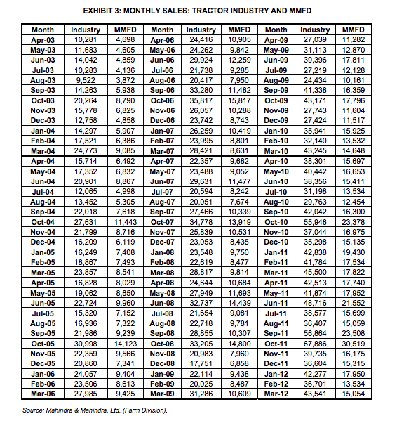
Available data 1

Slide 10
Available data 2
Tractor models | Industry | MMFD
Model 1 | 15,000 | 13,000
Model 2 | 20,000 | 22,000
Model 3 | 7,000 | 8,000

Slide 11
Available data 3
Sales | Seasons | Agr. Plot (total are) | PCI of rural population
12500 | Summer | 1010 | 8000
13900 | Winter | 2100 | 7600
11000 | Monsoon | 1300 | 6500
14120 | Monsoon | 1000 | 9000
12500 | Summer | 950 | 8200
15400 | Monsoon | 2200 | 9500
15000 | Winter | 2000 | 9000
14100 | Winter | 1190 | 6200
14500 | Summer | 1600 | 7000
15500 | Winter | 1900 | 9300

Slide 12
Mr. Menon finally ended the call after assuring the dealer that he would get the problem resolved.
How to help Mr. Menon using hypothesis testing

Slide 13
Research objective
Mr. Menon was concerned about the delivery delays. Therefore, he wanted to know whether the forecasting methodology was right. Forecasting depends on the available past data. He wanted to start with re-checking the data to examine the pattern again.

Slide 14
Research questions
1. He wanted to check whether the mean sales of two peak seasons across the nine years were same or significantly different.
2. He wanted to examine whether mean sales of a peak season and a lean season were actually significantly different or not.
3. He wanted to know whether there were any significant difference in the sales of peak seasons between last four years, 2008, 2009, 2010 and 2011.

Slide 15
Research questions
4. Is there any variation in sales of different model, if compared with MMFD and entire market?
5. What could be the factors influencing sales of tractors?
6. How to predict the sales for future months?

Slide 16
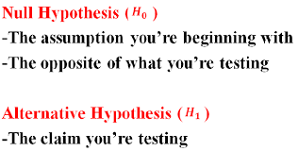

Slide 17
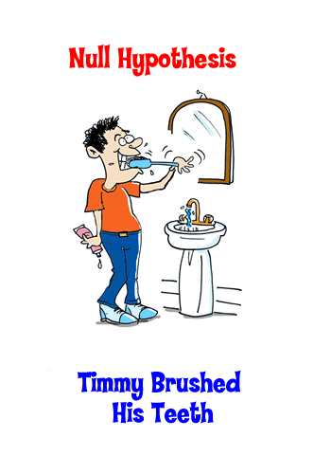


Slide 18


Slide 19


Slide 20


Slide 21
1st hypothesis
H₀: Mean sales of peak season 1 (April to June) = Mean sales of peak season 2 (September to November)
H₁: Mean sales of peak season 1 (April to June) ≠ Mean sales of peak season 2 (September to November)

Slide 22
2nd hypothesis
H₀ : Mean sales of peak season(April to June & September to November) = Mean sales of lean season(Rest of the months)
H₁ : Mean sales of peak season(April to June & September to November) > Mean sales of lean season(Rest of the months)

Slide 23
3rd hypothesis
H₀ : Mean sales of peak season (2008)=Mean sales of peak season (2009)=Mean sales of peak season (2010)=Mean sales of peak season (2011)
H₁ : Mean sales of peak season (2008)≠Mean sales of peak season (2009)≠Mean sales of peak season (2010)≠Mean sales of peak season (2011)

Slide 24
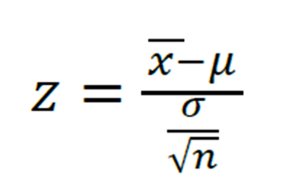
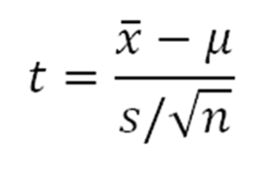
Which test for hypothesis 1? Test statistics for one sample case

Slide 25
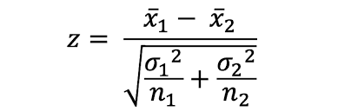
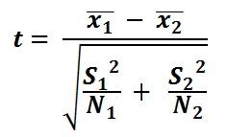
Which test for hypothesis 1? Test statistics for two sample case

Slide 26
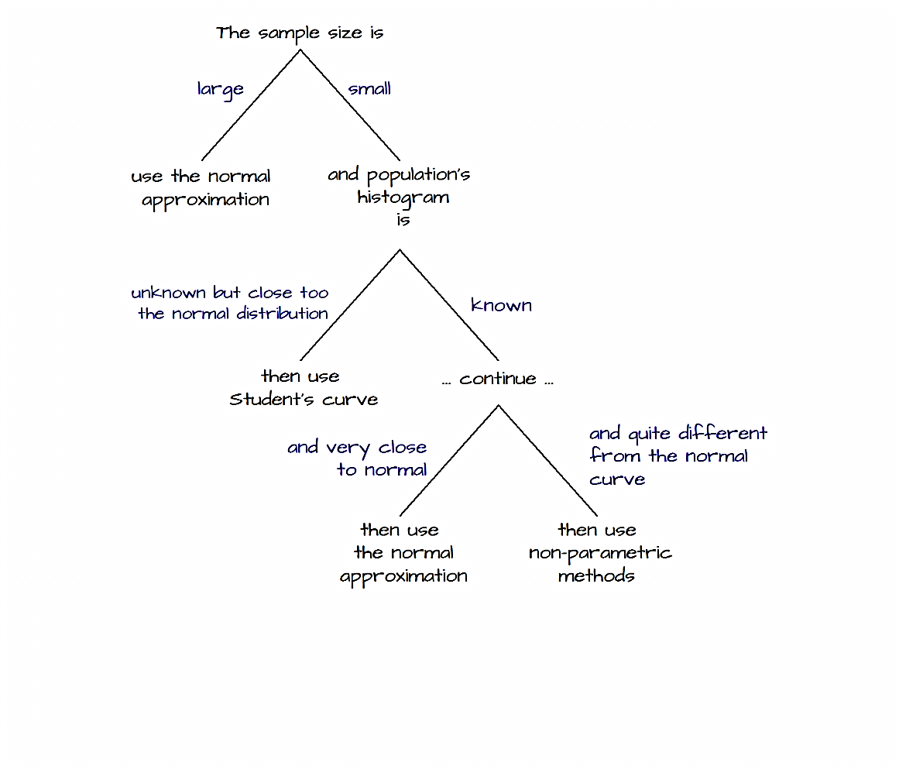
Decision

Slide 27
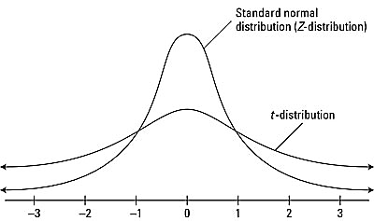

Slide 28
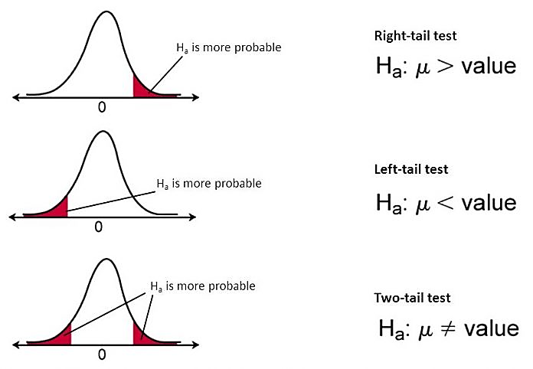
One and two tailed test

Slide 29
So, what is your decision?
Z or t test?
1 or 2 tailed test?

Slide 30
What is p-value
In statistics, the p-value is the probability of obtaining results as extreme as the observed results of a statistical hypothesis test, assuming that the null hypothesis is correct. The p-value is used as an alternative to rejection points to provide the smallest level of significance at which the null hypothesis would be rejected. A smaller p-value means that there is stronger evidence in favor of the alternative hypothesis.

Slide 31
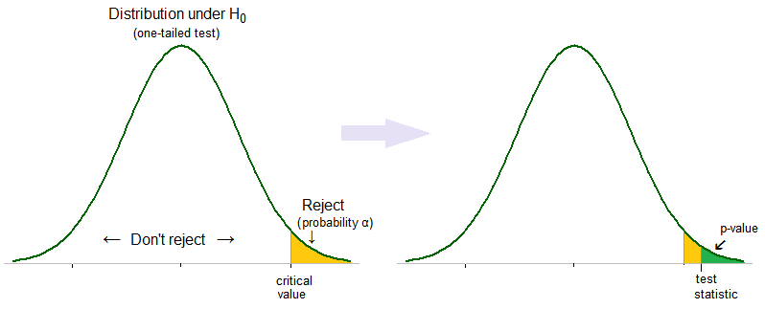
Acceptance or rejection of alternative hypothesis →p value

Slide 32
An example
A principal at a certain school claims that the students in his school are above average intelligence. A random sample of thirty students IQ scores have a mean score of 112.5. Is there sufficient evidence to support the principal’s claim? The mean population IQ is 100 with a standard deviation of 25.
Step 1: State the Null hypothesis. The accepted fact is that the population mean is 100, so: H0: μ<=100.
Step 2: State the Alternate Hypothesis. The claim is that the students have above average IQ scores, so:
H1: μ > 100.
The fact that we are looking for scores “greater than” a certain point means that this is a one-tailed test.
Step 3: Draw a picture to help you visualize the problem.

Slide 33
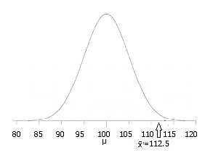

Slide 34
Step 4: State the alpha level. If you aren’t given an alpha level, use 5% (0.05).
Step 5: Find the rejection region area (given by your alpha level above) from the z-table. An area of .05 is equal to a z-score of 1.645.
Step 6: Find the test statistic using this formula: z score formula
For this set of data: z = (112.5-100) / (25/√30) = 2.74.
Step 6: If Step 6 is greater than Step 5, reject the null hypothesis. If it’s less than Step 5, you cannot reject the null hypothesis. In this case, it is greater (2.74 > 1.645), so you can reject the null.

Slide 35
How to modify this with p value?

Slide 36


For a right tail test
P<= $α$
Reject the null hypothesis
P >$α$
Cannot reject the null hypothesis

Slide 37
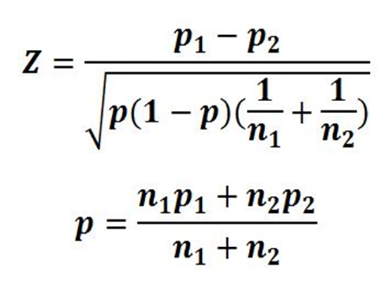
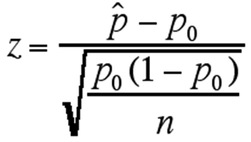
Test statistics for proportions

Slide 38
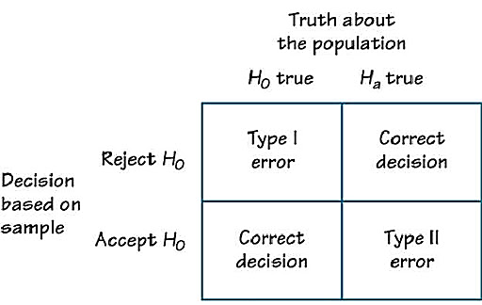
Type I & type II error

Slide 39
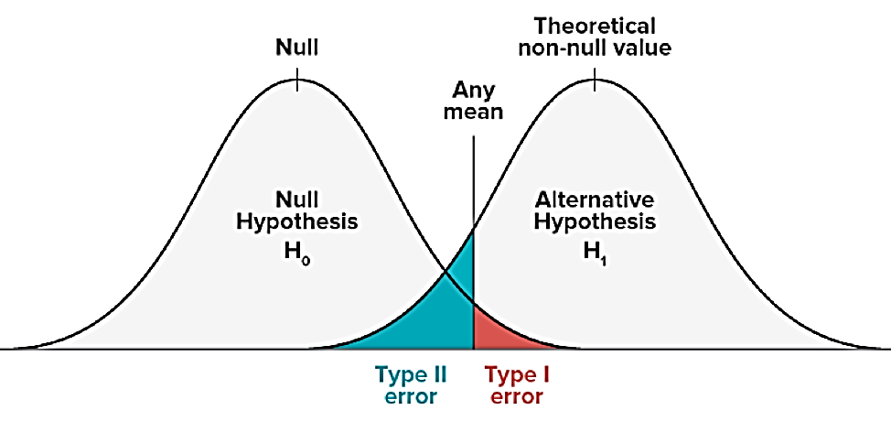
Calculate type I and type II error

Slide 40
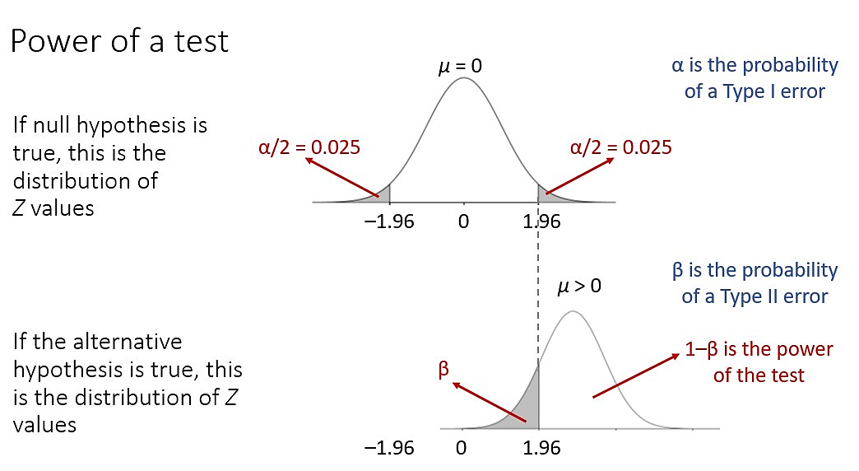
Power of a test

Slide 41
Suppose we are about to sample 36 values from a normally distributed population, where δ = 21 but µ is unknown. We are going to test:
H0: µ=50
H1: µ<50
α = .09
For what value of Z will we reject H0?

Slide 42
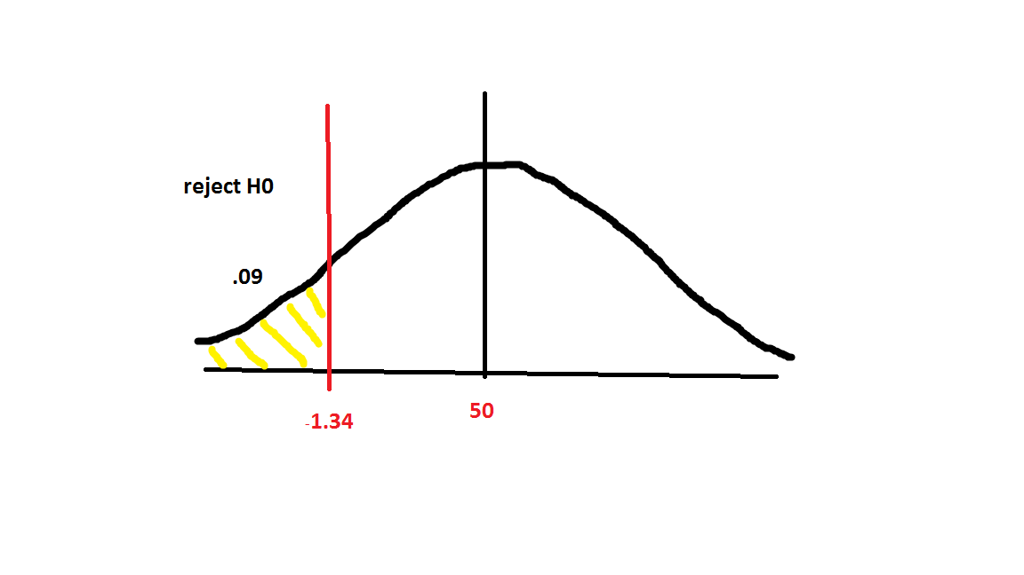

Slide 43
Calculate x bar from this equation with the other known values.
µ = 50
δ= 21
N= 36
Z= -1.34
X bar = 45.31

Slide 44
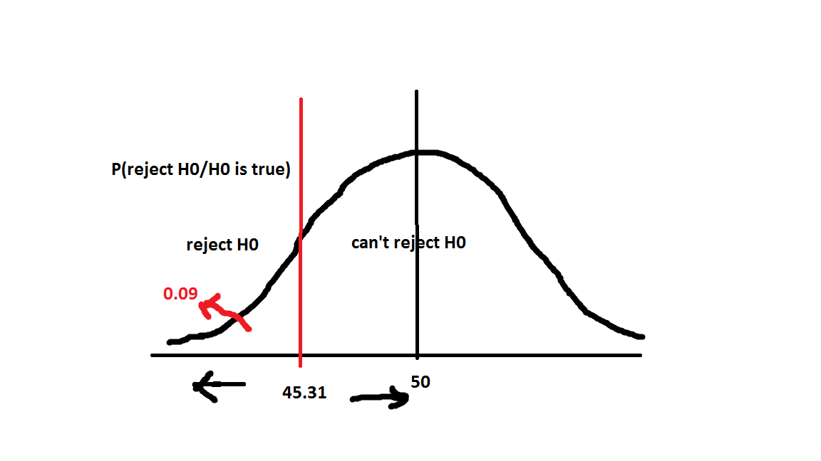
Type I error

Slide 45
If the true value of µ= 43, what is the probability of type II error?
H0: µ=50
H1: µ<50
Probability (do not reject H0 / µ=43)
We reject H0 if, X bar ≤ 45.31
Therefore, prob of type II error is,
=P (X bar > 45.31/ µ= 43)

Slide 46
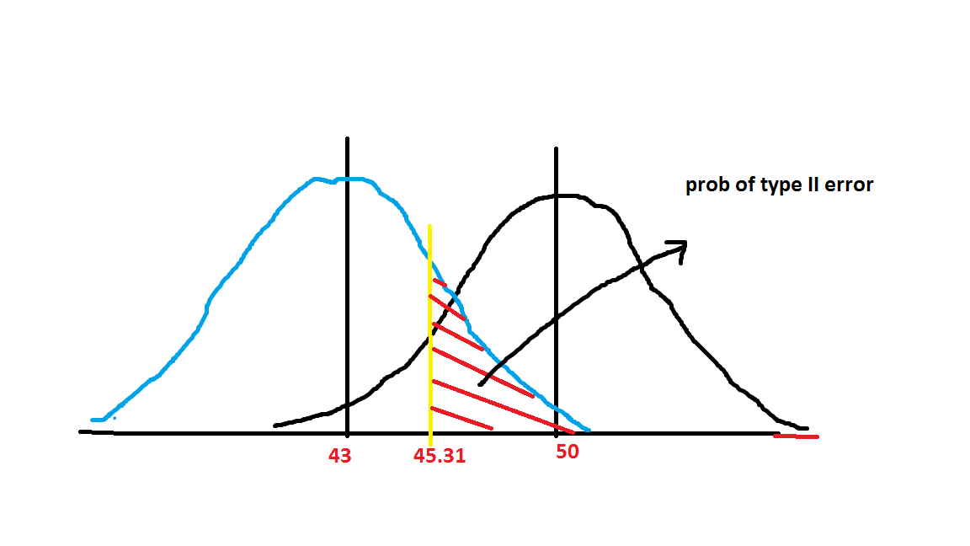

Slide 47

Z= $\frac{45.31−43}{21/√36}$
= 0.66
Therefore,
P (type II error) = P (Z > 0.66)
= 0.255

Slide 48
Power of a test
= 1 – probability of type II error
= 1 – 0,255
= 0.745

Slide 49
Which test for hypothesis 2?

Slide 50
Which test for hypothesis 3?

Slide 51
We cannot use Z or t test for hypothesis 3.
As these two tests can only be used to compare two means or two proportions.
Therefore, here we need to use F test.

Slide 52
F test
F-tests are named after its test statistic, F, which was named in honor of Sir Ronald Fisher. The F-statistic is simply a ratio of two variances. Variances are a measure of dispersion, or how far the data are scattered from the mean. Larger values represent greater dispersion.
Then why is the method comparing several means the 'analysis of variance', rather than 'analysis of means' themselves?
It is because that the relative location of the several group means can be more conveniently identified by variance among the group means than comparing many group means directly when number of means are large.

Slide 53
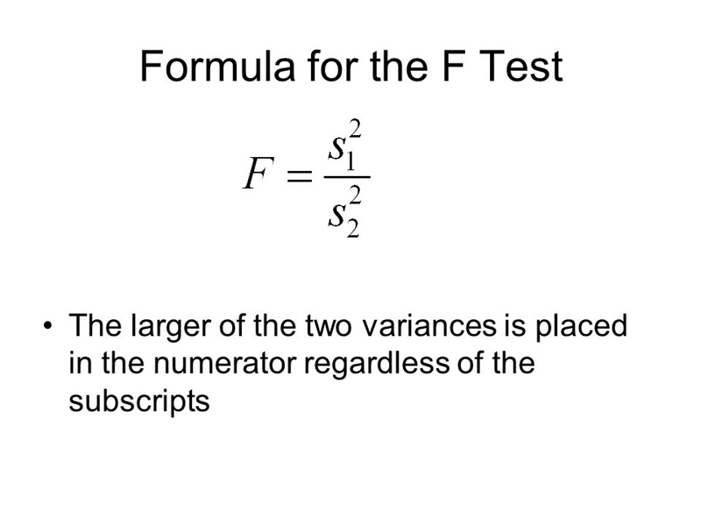
F test

Slide 54
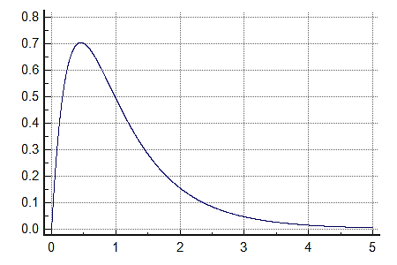
F distribution

Slide 55
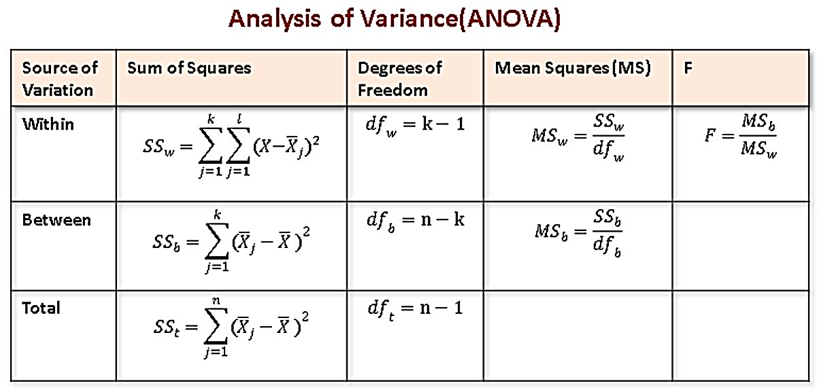
ANOVA

Slide 56

ANOVA example
The data below resulted from measuring the difference in resistance resulting from subjecting identical resistors to three different temperatures for a period of 24 hours. The sample size of each group was 5. In the language of design of experiments, we have an experiment in which each of three treatments was replicated 5 times.

Slide 57
The table
 | Level 1 | Level 2 | Level 3
 | 6.9 | 8.3 | 8.0
 | 5.4 | 6.8 | 10.5
 | 5.8 | 7.8 | 8.1
 | 4.6 | 9.2 | 6.9
 | 4.0 | 6.5 | 9.3
means | 5.34 | 7.72 | 8.56

Slide 58
STEP 1
Compute CM, the correction for the mean.
CM=(Total of all observations)²/N
total=(108.1)²/15=779.041
Step 2:
Compute SST
= sum of squares of all observations −CM.
=SS(Total)=(6.9)²+(5.4)²+…+(6.9)²+(9.3)²−CM
=829.390−779.041=45.439
The value of 829.390 is called the "raw" or "uncorrected " sum of squares.

Slide 59
STEP 3
Compute SSB,.
First we compute the total (sum) for each treatment.
T1=6.9+5.4+…+4.0=26.7
T2=8.3+6.8+…+6.5=38.6
T3=8.0+10.5+…+9.3=42.8
Then,
SSB=(26.7)²/5+(38.6)²/5+(42.8)²/5−779.041=27.897.
STEP 4
Compute SSE, the error sum of squares. Here we utilize the property that the treatment sum of squares plus the error sum of squares equals the total sum of squares. Hence,
SSE=SST−SSB=45.349−27.897=17.45.

Slide 60
The resulting ANOVA table is
Source SS DF MS F
between 27.897 2 13.949 9.59
within 17.452 12 1.454

Slide 61
Decision
The test statistic is the F value of 9.59.
Using an α of 0.05, we have F[0.05; 2,12]
If the test statistic is much larger than the critical value, we reject the null hypothesis of equal population means and conclude that there is a (statistically) significant difference among the population means.

Slide 62
Answer to research question 4
Is there any variation in sales of different model, if compared with MMFD and entire market?
(Available data 2)

Slide 63
Chi square distribution
A chi-square distribution is a continuous distribution with k degrees of freedom. It is used to describe the distribution of a sum of squared random variables. It is also used to test the goodness of fit of a distribution of data, whether data series are independent, and for estimating confidences surrounding variance and standard deviation for a random variable from a normal distribution.

Slide 64
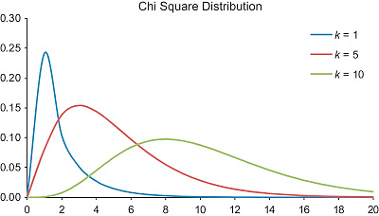

Slide 65
What is a chi square test?
There are two types of chi-square tests. Both use the chi-square statistic and distribution for different purposes:
A chi-square goodness of fit test determines if a sample data matches a population.
A chi-square test for independence compares two variables in a contingency table to see if they are related. In a more general sense, it tests to see whether distributions of categorical variables differ from each another.

Slide 66
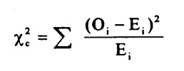
What is a chi-square statistic?
The formula for the chi-square statistic used in the chi square test is:
The subscript “c” are the degrees of freedom. “O” is your observed value and E is your expected value.

Slide 67
A low value for chi-square means there is a high correlation between your two sets of data. In theory, if your observed and expected values were equal (“no difference”) then chi-square would be zero — an event that is unlikely to happen in real life.

Slide 68
Null Hypothesis: The two categorical variables are independent
Alternative Hypothesis: The two categorical variables are dependent
Chi-Square Test Statistic: χ²=∑(O−E)² / E, where O represents the observed frequency. E is the expected frequency under the null hypothesis and computed by:
E= (row total × column total) / sample size
We will compare the value of the test statistic to the critical value of χ_{α}² with degree of freedom = (r - 1) (c - 1), and reject the null hypothesis if χ² > χ_{α}².

Slide 69
Is gender independent of education level? A random sample of 395 people were surveyed and each person was asked to report the highest education level they obtained. The data that resulted from the survey is summarized in the following table:
Question: Are gender and education level dependent at 5% level of significance? In other words, given the data collected above, is there a relationship between the gender of an individual and the level of education that they have obtained?
Answer

Slide 71
Here's the table of expected counts:
 | High School | Bachelors | Masters | Ph.D. | Total
Female | 50.886 | 49.868 | 50.377 | 49.868 | 201
Male | 49.114 | 48.132 | 48.623 | 48.132 | 194
Total | 100 | 98 | 99 | 98 | 395

Slide 72
So, working this out,
χ²=(60−50.886) ² / 50.886+⋯+(57−48.132) ² / 48.132
= 8.006
The critical value of χ² with 3 degree of freedom is X. If 8.006 > X, we reject the null hypothesis and conclude that the education level depends on gender at a 5% level of significance.

Slide 73
Example: "Which holiday do you prefer?“
Beach Cruise
Men 209 280
Women 225 248
Does Gender affect Preferred Holiday?
If Gender (Man or Woman) does affect Preferred Holiday we say they are dependent.

Slide 74
In a prior example we evaluated data from a survey of university graduates which assessed, among other things, how frequently they exercised. The survey was completed by 470 graduates. In the prior example we used the χ² goodness-of-fit test to assess whether there was a shift in the distribution of responses to the exercise question following the implementation of a health promotion campaign on campus. We specifically considered one sample (all students) and compared the observed distribution to the distribution of responses the prior year (a historical control). Suppose we now wish to assess whether there is a relationship between exercise on campus and students' living arrangements. As part of the same survey, graduates were asked where they lived their senior year. The response options were dormitory, on-campus apartment, off-campus apartment, and at home (i.e., commuted to and from the university). The data are shown below.

Slide 76
Based on the data, is there a relationship between exercise and student's living arrangement? Do you think where a person lives affect their exercise status? Here we have four independent comparison groups (living arrangement) and a discrete (ordinal) outcome variable with three response options. We specifically want to test whether living arrangement and exercise are independent!

Slide 77
Pancreaticoduodenectomy (PD) is a procedure that is associated with considerable morbidity. A study was recently conducted on 553 patients who had a successful PD between January 2000 and December 2010 to determine whether their Surgical Apgar Score (SAS) is related to 30-day perioperative morbidity and mortality. The table below gives the number of patients experiencing no, minor, or major morbidity by SAS category.
Question: What would be an appropriate statistical test to examine whether there is an association between Surgical Apgar Score and patient outcome? Using 14.13 as the value of the test statistic for these data, carry out the appropriate test at a 5% level of significance.

